Slide 1
Can You Feel it? Yes We Can!
Human Limitations in Design Theory
Dr Terence Love
Love Design and Research
Curtin University, Western Australia
Lancaster University, Management School, Lancaster, UK
IADE/UNIDCOM, Lisbon Portugal

Slide 2
Benefits
Reduce design failures
Improve theory
Increase income

Slide 3
2 feedback loops limitation
Everyone is limited in their thinking.
No one can understand unaided the behaviour of situations with two or more feedback loops
No amount of thinking, intuition, feelings, creativity or collaboration works on situations with 2 or more feedback loops

Slide 4
Basic design
Around half of design has no feedback loops

Slide 5


Simple design

Slide 6
Complicated designs
Complicated designs aremultiple simple designs

Slide 7

Complicated design

Slide 8
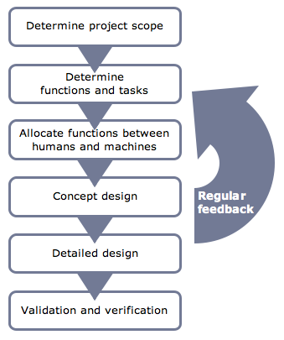
Feedback loop – single

Slide 9
Feedback loop single
Simple feedback loop – temperature of fridge

Slide 10
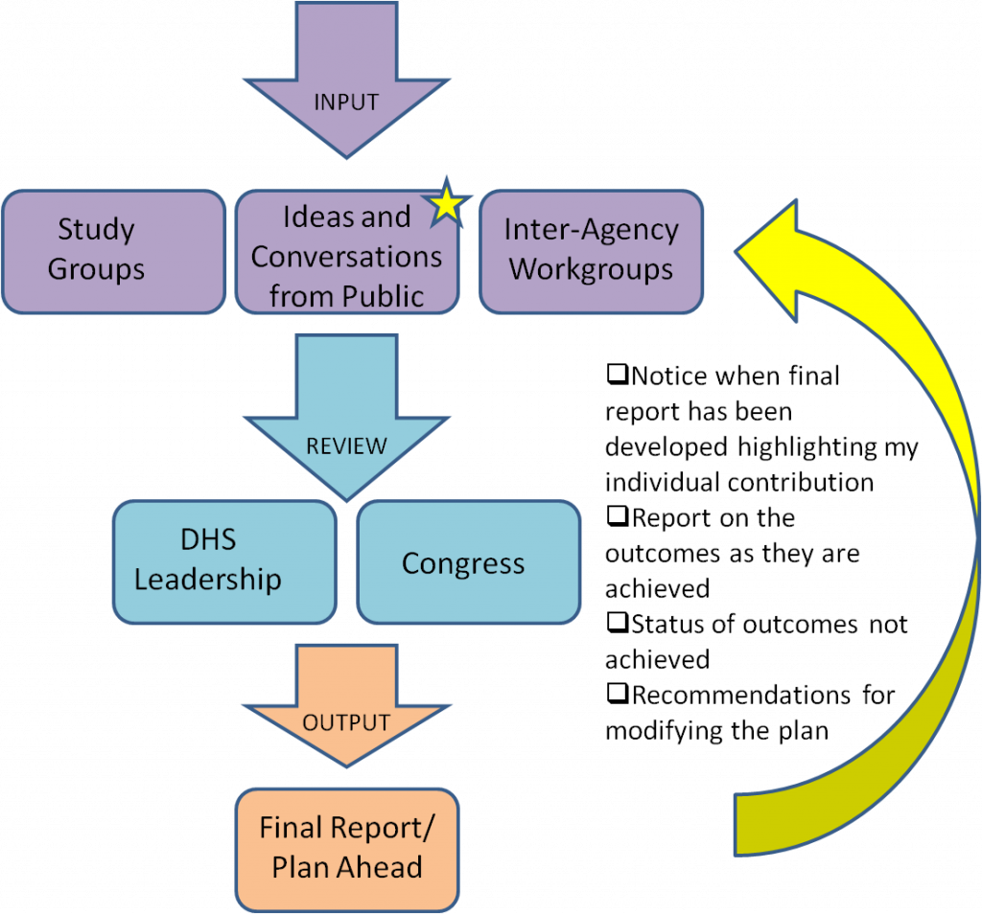
Feedback loop single

Slide 11
Quick test
Johar has $1.10 and buys two items.
The first item costs $1 more.
How much was the other item?

Slide 12
Answer
Most people answer $1 and 10c
The correct answer is $1.05 and 5c
This is a simple single feedback loop problem

Slide 13
Simple design – 1 feedback loop
Most Art and Design design methods assume situations comprise at most a single feedback loop

Slide 14
Complex design situations
All design requires the designer to be able to predict the behaviour of the outcome
Complex design situations are beyond human thinking

Slide 15
‘Complicated’ and ‘complex’
Simple and Complicated
Designs and designed interventions that are mostly successful
Straightforward
No feedback loops (or only one)
Can be complicated with multiple factors or simple with few factors
Complex designs
Types of designs and design interventions that are rarely successful and often fail
Not straightforward
Multiple feedback loops
Fail even when not complicated

Slide 16
‘2 feedback loop’ conjecture
Humans CAN predict behaviour of even complicated situations provided they have
less than 2 feedback loops
======================================
Humans CANNOT predict behaviour of complex situations with
2 or more feedback loops

Slide 17
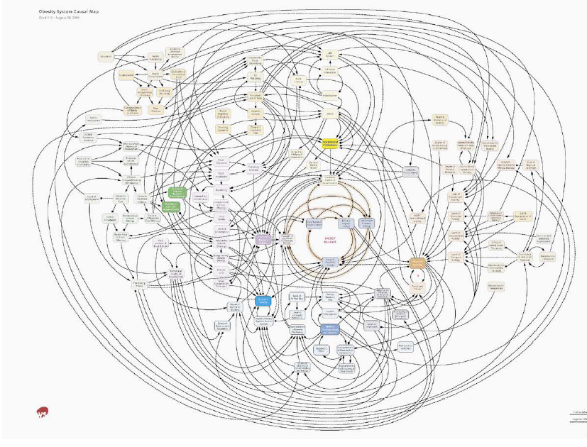
Complex design situations
More than
2 feedback loops
Addiction intervention design
Design of obesity reduction: simplified model of multiple interrelated feedback loops http://www.foresight.gov.uk/Obesity/12.pdf

Slide 18
Can you feel it? Yes we can…its an illusion!
Individuals feel that they can use intuition to understand complex design situations – they cannot
Individuals feel collaboration or participatory design will enable them to identify correct design solutions – they do not
Individuals feel they can use feelings and intuition to understand complex situations – they give the wrong answers

Slide 19
Solutions for Complex Design
Create a model of the design situation with all its feedback loops (causal loop diagram)
Convert this to an dynamic predictive model (system dynamic model)
Try out possible designs using the system dynamic model to SEE the outcomes predicted

Slide 20
Multi-feedback loop causal diagram of crime changes due to new rail line
Crime prevention feedback loops in new rail corridor situation
Preliminary model of relationships affecting crime and crime prevention interventions in a rail corridor
(unpublished Love, T, Cooper, T, Cozens, P, Morgan, F and Clare, J)

Slide 21
Early stage system dynamic model of suburban/rail related crime
Preliminary model of relationships affecting crime and crime prevention interventions in a rail corridor
(unpublished Love, T, Cooper, T, Cozens, P, Morgan, F and Clare, J)

Slide 22
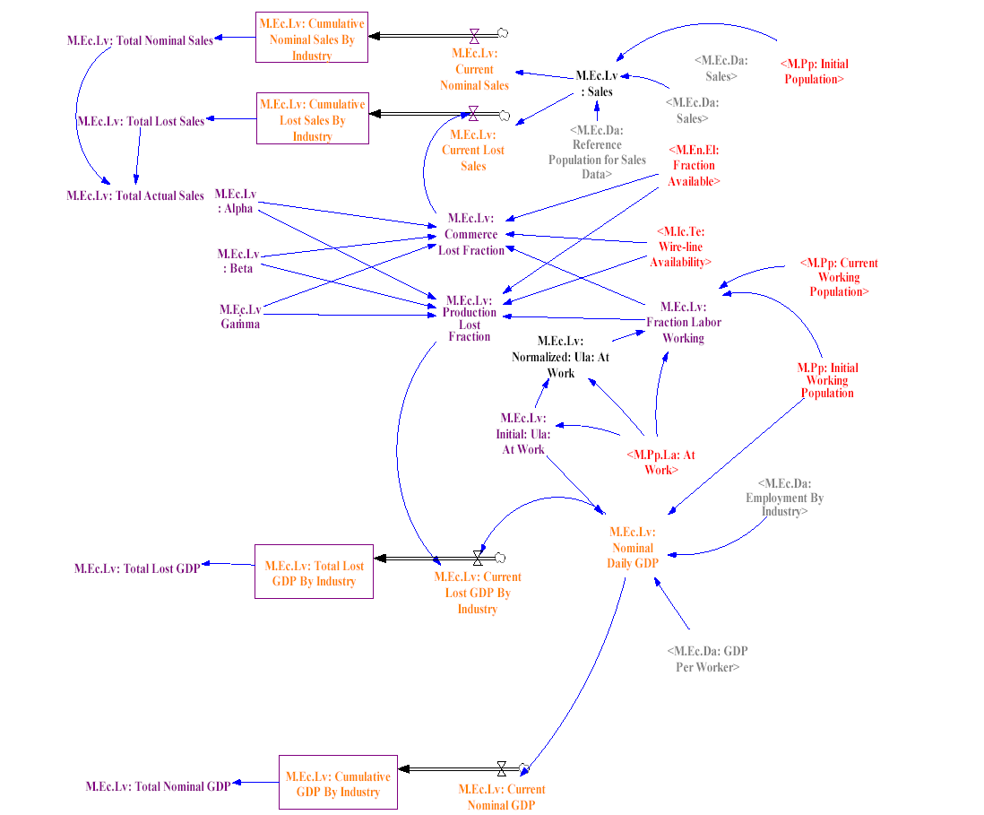
Design of pandemic intervention
Ewers, M. and Dauelsberg, L. (2007) Pandemic influenza mitigation strategies and their economic impacts. In Fielden, K and Sheffield, J. Systemic Development: Local Solutions in a Global Environment. Proceeding s of 13th ANZSYS Conference. Auckland: Unitech and ANZSYS.

Slide 23
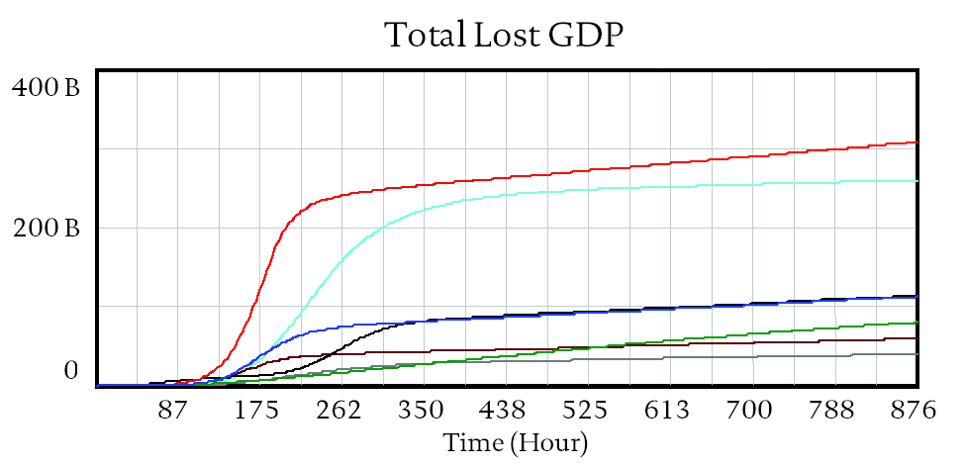
Example: pandemic intervention
Ewers, M. and Dauelsberg, L. (2007) Pandemic influenza mitigation strategies and their economic impacts. In Fielden, K and Sheffield, J. Systemic Development: Local Solutions in a Global Environment. Proceeding s of 13th ANZSYS Conference. Auckland: Unitech and ANZSYS.

Slide 24
Participation/Collaboration
Workflow for Complex Design
Gather information from stakeholders (using participation/collaboration to identify feedback loops.
Design causal loop diagram
Create predictive system dynamic model of the design and context
Designers use the model to SEE design outcomes and this makes up for the human biological limitations in understanding feedback loops

Slide 25
Summary
Designers cannot understand situations with 2 or more interlinked feedback loops.
Distinguishing line between complicated and complex design is 2 or more feedback loops
Intuition, feelings, emotions and creativity do not apply to complex design
Systems Dynamics tools resolve the problem
Need to charge additional design fees for complex design situations .

Slide 26
Questions?

