Slide 1
Design Guideline Gap and 2 Feedback Loop Limitation
Dr Terence Love
Curtin University, Australia,
Lancaster University, UK,
IADE/UNIDCOM, Portugal
t.love@love.com.au

Slide 2
History of this research
2001 Analysis and prediction of Design & Emotion field (D&E conference, Loughborough)
2009 Critical analysis of D&E literature comparing history of D&E with predictions of 2001 (IASDR conference, Seoul)
Helpful comments by Don Norman and Paul Hekkert

Slide 3
Two ‘gaps’ in Design & Emotion
Two issues cause Design and Emotion design failures:
Design guideline ‘gap’
2 Feedback Loop Limitation

Slide 4
Two primary purposes of design research are:
Guidelines for producing specific design outcomes
Prediction of behaviours resulting from design outcomes
If Design and Emotion research cannot fulfill these two tasks it is useless to designers.

Slide 5
Why important?
If Design & Emotion research doesn’t fulfil these two tasks or gives the wrong answers then:
Design failures
Disasters and losses for users
Financial claims against designers

Slide 6
Design Guidelines
The role of design guidelines is to direct design decisions.
Design guidelines specify elements of design solutions
To be effective, design guidelines must be concrete and specific.
  Use this font, with this leading and place the text in this way
  Display images with this kind of pan and zoom at these timings
  Use a maximum piston speed of 30 m/s for these materials
  The optimal layout for this kind of circuit is as shown’

Slide 7
Research and design guidelines
Implicit claim in D&E literature is:
Design and Emotion research benefits designers because it provides design guidelines

Slide 8
Evidence – the D & E research literature
Literature review indicates widespread failure to create design guidelines from D& E research
This problem has been ‘hidden in full view’
  Confusion between ‘information given to designers’ and ‘information to guide design decisions.

Slide 9
Evidence: Design & Emotion website
An easy to access example are the ‘tools and methods’ on the D&E society website. www.designandemotion.org
None of the D&E research methods result in design guidelines.
‘Cabinet’– data collection method
‘Vision in Product Design’– idea generation method/ business process flowchart
All the ‘design research methods on the D&E website show the ‘design guideline gap’ except the Kn6 IBV Kansei method – an attempt at brute force linking user info to gross design elements

Slide 10
2 Feedback Loop Limitation

Slide 11
D&E research applies only to ‘simple’ design situations -
Review of D&E research literature shows:
D&E field seems unaware of distinctions between design situations that are ‘simple’, ‘complicated’ and ‘complex’
Almost zero awareness of the 2 Feedback Loop Limitation

Slide 12


‘Simple’ design situation

Slide 13

‘Complicated’ design situation

Slide 14
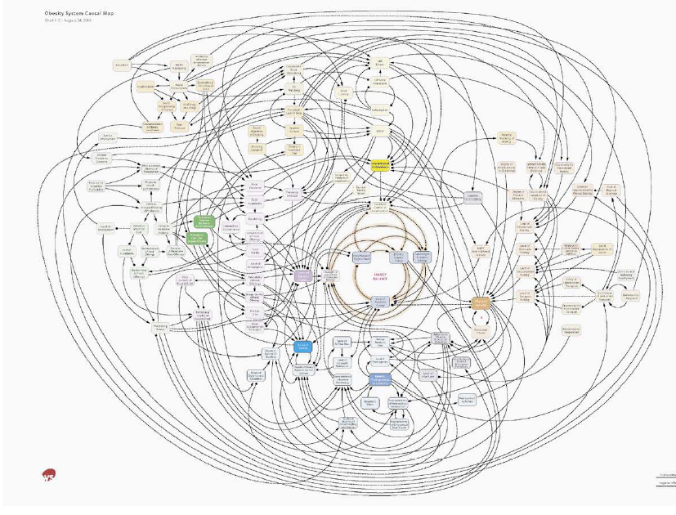
‘Complex’ design situation
More than
2 feedback loops
Addiction intervention design
Design of obesity reduction: simplified model of multiple interrelated feedback loops http://www.foresight.gov.uk/Obesity/12.pdf

Slide 15
Another ‘complex’ design situation
Crime prevention feedback loops in new rail corridor
Preliminary model of relationships affecting crime and crime prevention interventions in a rail corridor
(unpublished Love, T, Cooper, T, Cozens, P, Morgan, F and Clare, J)

Slide 16
Design & Emotion and ‘complex’ design
Literature of Design & Emotion assumes no feedback loops or at most a single feedback loop.

Slide 17
2 Feedback Loop Limitation
Biologically humans are limited in their cognition and emotional abilities:
No one can understand or predict unaided the behaviour of situations with two or more feedback loops
No amount of thinking, intuition, feelings, creativity, emoting, affective judgement or collaboration works on design situations with 2 or more feedback loops
Current approaches to D&E research and design methods typically do not apply to complex design situations.

Slide 18
New directions for D&E
Urgent need for new direction in Design & Emotion:
Redirect research funding to develop new ways to create design guidelines
Develop new forms of design research and practice for creating of D&E design guidelines
Awareness that data about users and emotions and existing D&E research are not design guidelines
Development of new forms of D&E research and design methods for complex design situations.

Slide 19
Questions?
Dr Terence Love t.love@love.com.au

