Slide 1

Confidentiality
Risks for Engineers:
5 Tools for Secure Engineering Communications
Dr. Terence Love FDRS, AMIMechE, MISI
IT Coordinator, IMechE Australian Branch
Director, Love Services Pty Ltd
admin@loveservices.com.au

Slide 2
Event notes:
The following presentation is for educational purposes and was presented on 16 April 2015 as a joint technical lecture of the Institution of Mechanical Engineers, Engineers Australia, the American Society of Mechanical Engineers and the Australian Society for Bulk Solids Handling at the Engineers Australia Auditorium, West Perth.
The presenter was Dr Terence Love, IT Coordinator of the Institution of Mechanical Engineers Australian Branch.

Slide 3
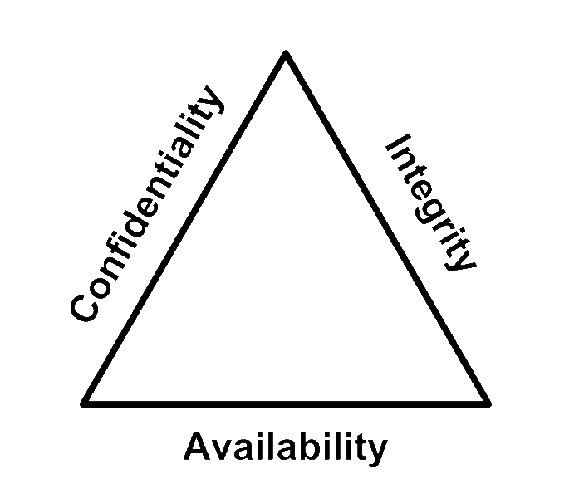
Confidential
Confidential means:
Intended to be kept secret
Entrusted with private or restricted information
Confidentiality is an arrangement to prevent sensitive
information from reaching the wrong people while ensuring the right people can access it.
AIC
Triad

Slide 4
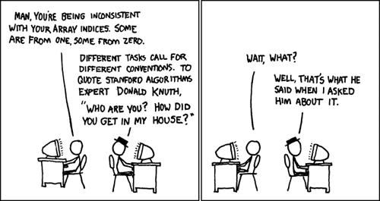
Confidentiality
Xkdc –donal-knuth

Slide 5
Confidential Content
Content is the knowledge and information you see or hear in:
Word documents
Emails
Websites
Excel files
Databases
Audio & video recordings
Books
Messages
Phone calls
….
Content is the content

Slide 6
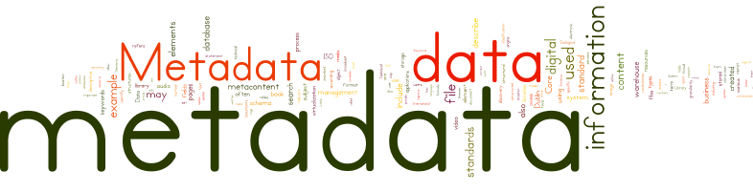
Metadata
Metadata is information about data and is often attached to that data.
  Document metadata includes author, time and date, who edited it, etc.
  Image metadata includes owner, how it was created, exposure info, where it was created, keywords etc.
  Video metadata can include information about creator, where created, what is in the video at different points
  Communication metadata records who sent which information to who, what you did when, where and with who.

Slide 7
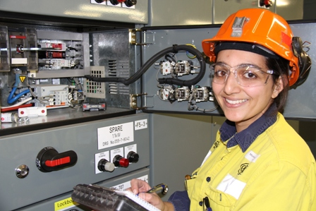
Attacks on confidential content & metadata
Attacks on your confidential content and meta-data typically have different purposes:
Confidential content attacks – someone wants to know what someone else knows
Confidential metadata attacks – someone wants to put pressure on someone else

Slide 8
Confidentiality of communication
Confidentiality of engineers communication is at risk when:
  Information is sat on servers – hacking of computers
  Information is moving – hacking of networks, wireless, cables
  Password are recorded – passwords enable access to other information and systems
  Engineers and their behaviours are indirectly identified – meta-data collection
  Engineers and their activities are directly recorded – surveillance
  Communication and data modification - records are intercepted and changed

Slide 9
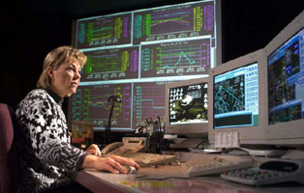
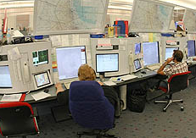
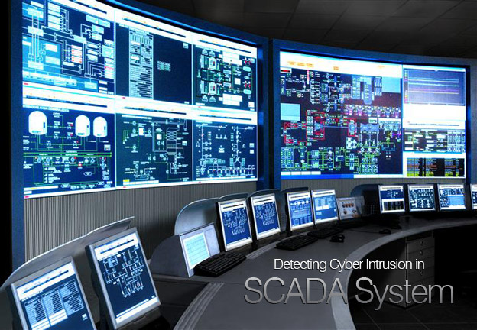
Scenario 1: Terrorism risks
SCADA systems remotely monitor & control essential services - electricity, gas, water, waste treatment and transport systems.
Mary is an engineering manager whose computer has software to make SCADA changes.
SCADA changes can result in loss of life, loss of services to a city, and high-levels of environmental contamination.
Mary also needs access to confidential information, technical documentation, online discussions with colleagues, password access to secure systems and software updates.
What are the terrorism risks associated with Mary’s position?

Slide 10
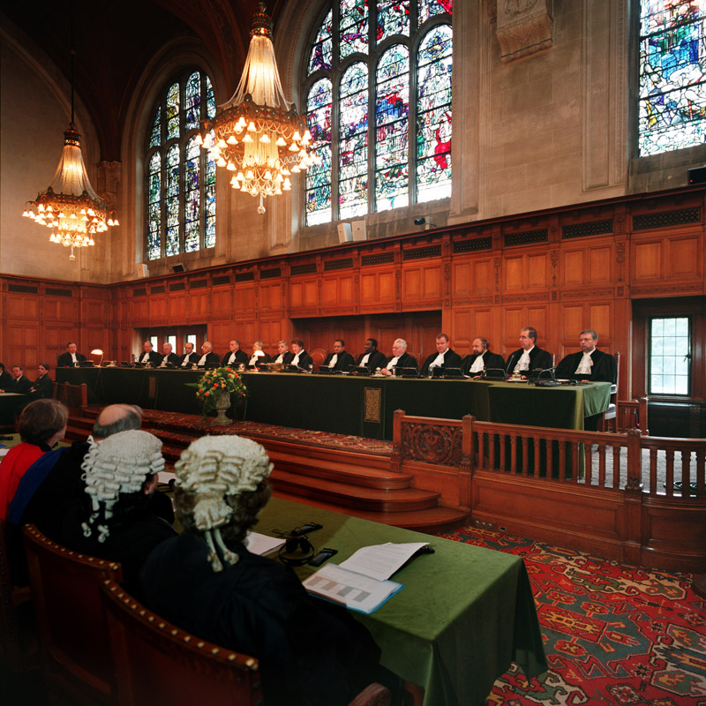
Scenario 2: National economic risks
A small 3rd world nation has significant amounts of oil within its territorial boundaries. A powerful nearby 1st world country believes it is justified to claim the oil and attempts to redraw its territorial boundaries so all the oil is on its side.
During negotiations, discussions about the oil, technology and territory are compromised by bugging the smaller nation’s cabinet room by the larger nation.
The result is3$Bn/ year loss from the smaller 3rd world nation to the larger 1st world nation. The issue is now with the ICJ in the Hague.
What are the national economic risks due to lack of confidentiality?

Slide 11
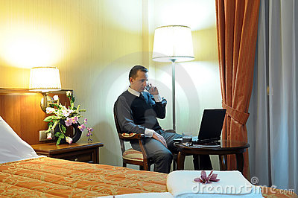
Scenario 3: Password shoulder surfing
Peter is a senior engineering designer for a large corporation collaborating with engineers overseas.
His hotel room is often his workspace and he uses the chair, table and light provided.
Peter is unaware of tiny video camera in the ceiling above his keyboard recording all his key presses, especially passwords.
He is also unaware all sounds are recorded, phone is intercepted, internet communications are recorded. When he leaves his computer in the safe, it is accessed and the data copied.
What are the risks associated with Peter’s position?

Slide 12

Scenario 4: Engineer whistle-blowers
Many whistle-blowers are engineers, and historically one of the reasons engineering societies formed was to protect such members.
Engineers shall ‘act appropriately, and in a professional manner, when you perceive something to be wrong’ (Engineers Australia); and ‘shall conduct their professional work … with due regard for the welfare of the people’ (IMechE).
2 main confidential communication issues:
How to protect a whistle-blower, and keep them anonymous?
How to protect others from release of confidential information when the whistle is blown?
How can confidential communications be done achieved for engineer whistle-blowing?
A whistleblower is a person who exposes misconduct, alleged dishonest or illegal activity in an organization.
US vehicle safety campaigner Ralph Nader coined the phrase in the early 1970s

Slide 13

Scenario 5: Engineers in volatile places
James, an expat mechanical engineer working in a volatile country risks kidnapping, violence, disease, accidents, blackmail, corruption, terrorism, computer & information theft.
Confidentiality risks include:
  Details of James’ location and timetable
  Confidential technical data
  Compromised communication with base
  Operational weaknesses (including illness)Censorship and local law-related risks
What other kinds of risks from poor confidentiality of communication does James have?

Slide 14
Reminder: Confidentiality targets for attacks
Data or content at rest – on servers , computers, hard drives, cloud, phones, repositories
Data or content in motion – in networks, wireless, the Internet, phonelines
Messages at rest – on servers , computers, hard drives, cloud, phones
Messages in motion – in networks, wireless, the Internet, phonelines
Metadata about content or communications at rest or in motion

Slide 15
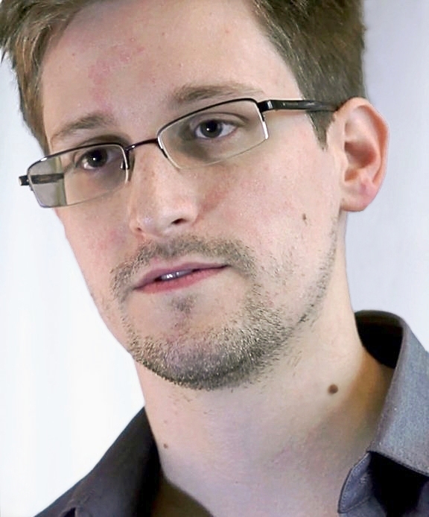
Creating a Threat Model
Use the following questions for all ‘at risk’ information and communications to create a Threat Model:
What do you want to protect? (can be people, information, company, physical things…)
Who is trying to do something I don’t want? Why?
What can they do?
What happens if they succeed?
Then create a security plan by asking:
What security processes will protect against the above?

Slide 16
5 Tools for Secure Engineering Communications
Purpose: use tools to secure engineering communications to protect engineers, businesses, the public.
Five tool areas are:
Protect data (moving and at rest)
Protect messages (moving and at rest)
Protect personal metadata
Protect passwords
Preserve anonymity where necessary for engineers’ safety
Note: In most cases, it is identity that needs to be confirmed rather than

Slide 17
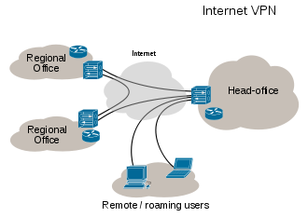
Virtual Private Networks (VPN)
Private networks are those that exist within a trusted company and are secured and inaccessible to outsiders.
Virtual Private Networks (VPN) are outside networks that behave as if they were securely inside.
All external communications go via the internal VPN server
VPN’s external communications are encrypted, including requests for webpages, which go through the VPN server
Using a VPN provides some security on public open wifi (see the wifi pineapple problem, later)
VPN server

Slide 18
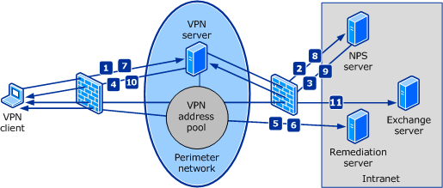

VPNs and engineers’ travel
VPNs offer good information security whilst travelling
  All communications are encrypted to your VPN server
  Good protection for using insecure wifi while travelling
  Data can be on server in office rather than on laptop/tablet/phone
  Assume ALL public wifi is attacked and recorded
Where possible use a company VPN when travelling.
If not, and it is necessary to use public wifi then buy traffic at a VPN – eg Private Tunnel (www.privatetunnel.com/home/ ) at 500Gb/$50

Slide 19

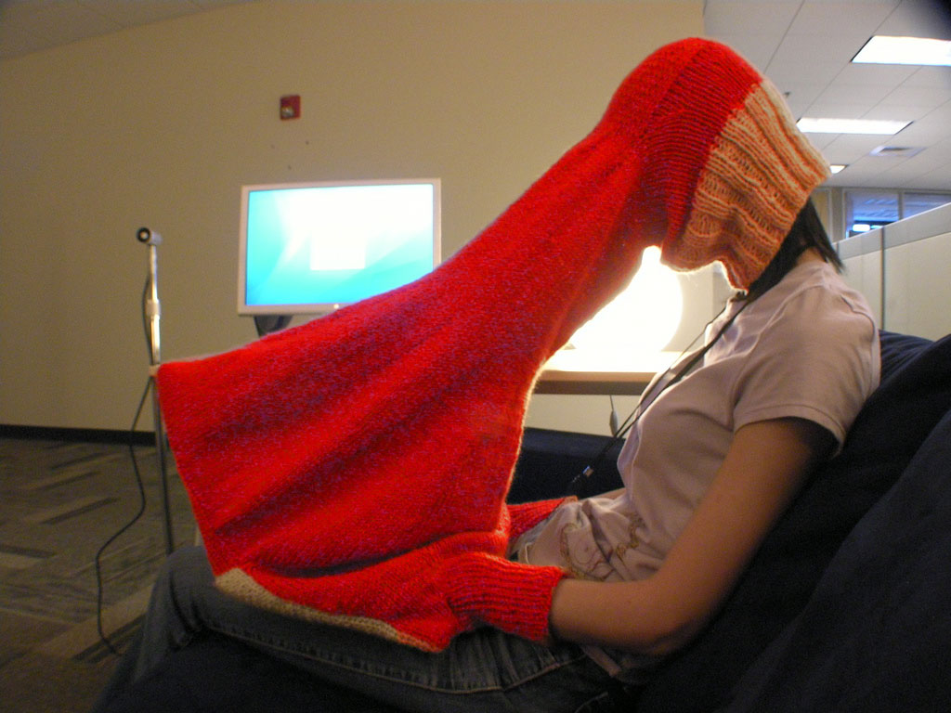
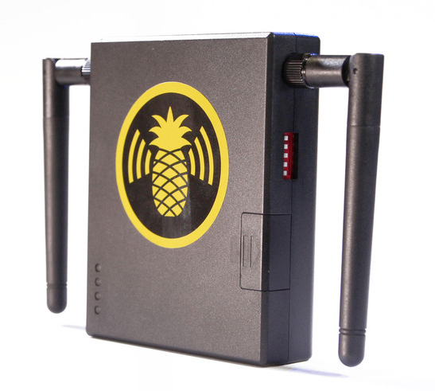
Attacks on VPN communications
Three attacks on confidentiality of VPNs are:
Poor password management (use password manager)
Shoulder surfing /video surveillance (use a towel or hood if necessary to securely enter passwords)
WiFi Pineapples are a man-in-the-middle attack (disable ‘connect to remembered access points’ on your computer, or, better, use a 3G modem rather than wifi)

Slide 20
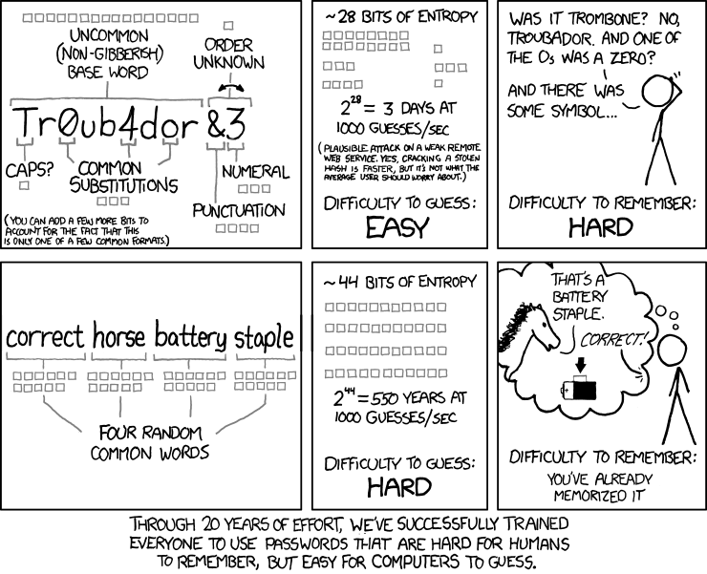
Passwords
https://xkcd.com/936/

Slide 21
Password Managers
Good passwords are:
  A random long mix of lower/upper case, numbers and symbols (@ # $ % ^ etc)
  Used for only one login
  Changed often
Most engineers are likely to have dozens or hundreds of passwords.
Passwords are difficult to remember, and easy for computers to guess.
The only satisfactory solution at this point seems to be:
Use a secure password manager

Slide 22
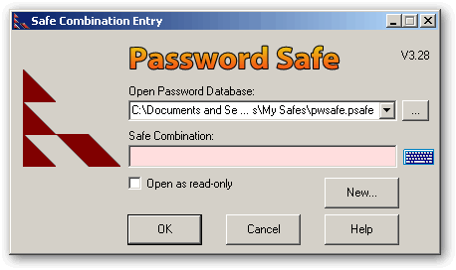
Password managers
Password managers store passwords securely
You need remember one very secure password and copy the others as needed from the password manager.
You can layer security protection and keep the password data off your computers or the cloud.
Secure your password manager on encrypted USB and remove when not in use. Use a hardware-encrypted USB, e.g. IronKey in preference to software-encryption or layer them
Backup your password database and put it somewhere secure!
Password Safe
KeepassX
KeyChain
LastPass
and many others

Slide 23
Private and Public Key encryption
-----BEGIN RSA PRIVATE KEY-----
MIIEpQIBAAKCAQEA3Tz2mr7SZiAMfQyuvBjM9Oi..Z1BjP5CE/Wm/Rr500P
RK+Lh9x5eJPo5CAZ3/ANBE0sTK0ZsDGMak2m1g7..3VHqIxFTz0Ta1d+NAj
wnLe4nOb7/eEJbDPkk05ShhBrJGBKKxb8n104o/..PdzbFMIyNjJzBM2o5y
5A13wiLitEO7nco2WfyYkQzaxCw0AwzlkVHiIyC..71pSzkv6sv+4IDMbT/
XpCo8L6wTarzrywnQsh+etLD6FtTjYbbrvZ8RQM..Hg2qxraAV++HNBYmNW
s0duEdjUbJK+ZarypXI9TtnS4o1Ckj7POfljiQI..IBAFyidxtqRQyv5KrD
kbJ+q+rsJxQlaipn2M4lGuQJEfIxELFDyd3XpxP..Un/82NZNXlPmRIopXs
2T91jiLZEUKQw+n73j26adTbteuEaPGSrTZxBLR..yssO0wWomUyILqVeti
6AkL0NJAuKcucHGqWVgUIa4g1haE0ilcm6dWUDo..fd+PpzdCJf1s4NdUWK
YV2GJcutGQb+jqT5DTUqAgST7N8M28rwjK6nVMI..BUpP0xpPnuYDyPOw6x
4hBt8DZQYyduzIXBXRBKNiNdv8fum68/5klHxp6..4HRkMUL958UVeljUsT
BFQlO9UCgYEA/VqzXVzlz8K36VSTMPEhB5zBATV..PRiXtYK1YpYV4/jSUj
vvT4hP8uoYNC+BlEMi98LtnxZIh0V4rqHDsScAq..VyeSLH0loKMZgpwFEm
bEIDnEOD0nKrfT/9K9sPYgvB43wsLEtUujaYw3W..Liy0WKmB8CgYEA34xn
1QlOOhHBn9Z8qYjoDYhvcj+a89tD9eMPhesfQFw..rsfGcXIonFmWdVygbe
6Doihc+GIYIq/QP4jgMksE1ADvczJSke92ZfE2i..fitBpQERNJO0BlabfP
ALs5NssKNmLkWS2U2BHCbv4DzDXwiQB37KPOL1c..kBHfF2/htIs20d1UVL
+PK+aXKwguI6bxLGZ3of0UH+mGsSl0mkp7kYZCm..OTQtfeRqP8rDSC7DgA
kHc5ajYqh04AzNFaxjRo+M3IGICUaOdKnXd0Fda..QwfoaX4QlRTgLqb7AN
ZTzM9WbmnYoXrx17kZlT3lsCgYEAm757XI3WJVj..WoLj1+v48WyoxZpcai
uv9bT4Cj+lXRS+gdKHK+SH7J3x2CRHVS+WH/SVC..DxuybvebDoT0TkKiCj
BWQaGzCaJqZa+POHK0klvS+9ln0/6k539p95tfX..X4TCzbVG6+gJiX0ysz
Yfehn5MCgYEAkMiKuWHCsVyCab3RUf6XA9gd3qY..fCTIGtS1tR5PgFIV+G
engiVoWc/hkj8SBHZz1n1xLN7KDf8ySU06MDggB..hJ+gXJKy+gf3mF5Kmj
DtkpjGHQzPF6vOe907y5NQLvVFGXUq/FIJZxB8k..fJdHEm2M4=
-----END RSA PRIVATE KEY-----
Many kinds of security use private and public key encryption – emails, VPN, SSH, Instant messaging
Private and Public Keys are large random numbers =>>
Private key – You keep very safe
Public key – you give to everyone
Bob has: Bob’s Private key and Alice’s Public key
Alice has Alice’s Private Key and Bob’s Public Key

Slide 24
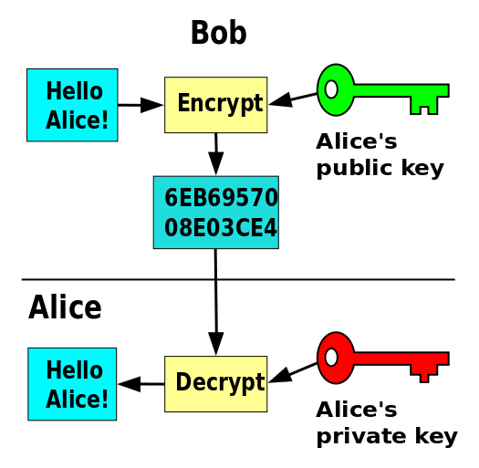
Public—Private Key secure email
Bob sends Alice an email encrypted with Alice’s Public key
Alice decrypts it with her private key and reads it.
Alice sends Bob a reply encrypted with Bob’s Public key
Bob decrypts it with his private key and reads it.
General rule:
Encrypt with PUBLIC KEY
Decrypt with PRIVATE Key
Can be managed automatically in email software
Encrypted
email

Slide 25
Other public-private key encryption uses
  Instant messaging
  Https in web browsers
  SSH (basis of some VPNs)
  Digital signing of documents
  GPG support for email such as Outlook
  Secure file transfer

Slide 26


Public--private key software
GPG software is perhaps most common to manage public and private keys.
History: PGP of Phil Zimmerman was the standard public-private key encryption method. Commercially it is now available via Symantec. GPG was created as the open source free equivalent of PGP and is fully compliant with the OpenPGP standard.
GPG4Win – for Windows
GPGSuite – for Mac
Gnu Privacy Assistant - for Linux
https://www.gnupg.org/
See also Putty and PuttyGen
And for Mac and Linux use terminal and ssh-keygen

Slide 27
Drive encryption
Hard drives that are not fully encrypted can be removed and files accessed
Full-drive encryption secures data and messages at rest (examples include: Bitlocker (Win), Filevault (OSX), cryptsetup (Linux)
USBs and memory cards can be encrypted via software or hardware. Hardware encrypted USBs are more secure, more expensive and slower (Ironkey, Kingston, Sandisk, Kanguru)
TrueCrypt (use only 7.1a) can create hidden volumes for situations where personal security and data are both important.

Slide 28
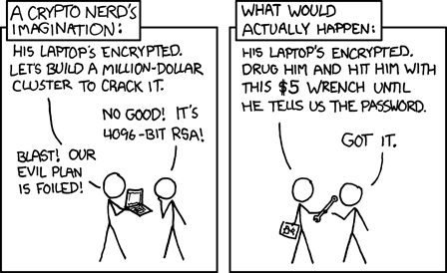
For engineers working in personally highly
dangerous situations, expert advice should be sought on information securing.
It may be better to have passwords held by a different person or secure information managed in a different manner.

Slide 29
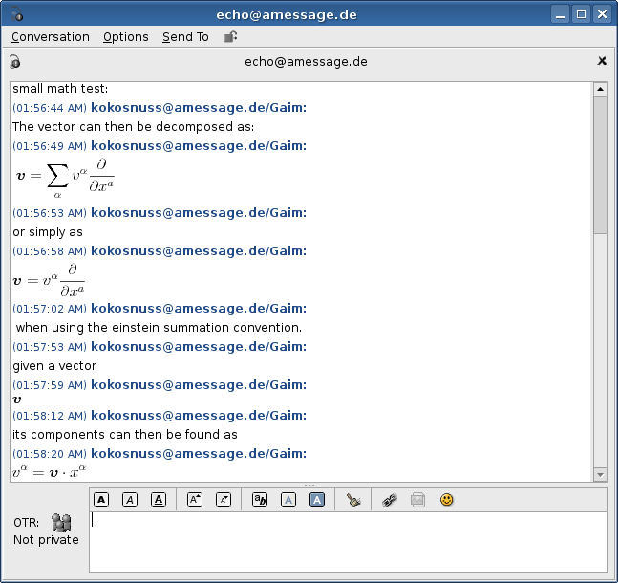
Secure instant messaging
Secure instant messaging is an effective communication tool.
Provides ‘stealth’ online presence
Messages are encrypted
Does not log or store ANY information about messages or contents or sessions
Does not rely on 3rd party servers
For Windows - Pidgin (https://pidgin.im/), TorChat
For Mac – OfficeChat, OTR and Pidgin
For Linux – Pidgin, OTR
Skype texts are also encrypted

Slide 30
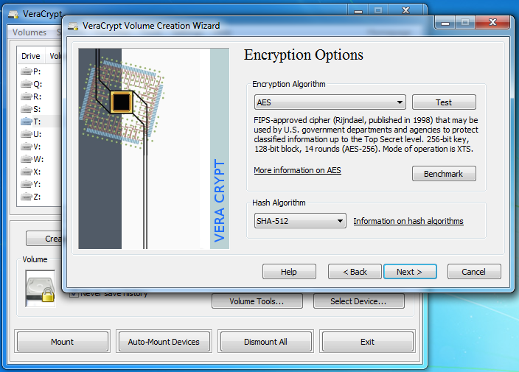
File encryption software
File encryption, especially ‘on-the-fly’ encryption, can protect files and folders at rest and in motion.
Examples include:
Windows: Bitlocker, Truecrypt 7.1a, Veracrypt, GnuPG, 7-Zip
Mac: FileVault, Disk Utility, AESCrypt, Veracrypt
Linux: GnuPG, gensfsm, openSSL, AESCrypt, Veracrypt
File encryption depend on strong passwords (usually necessary to use a password manager)

Slide 31

TAILS – amnesic incognito secure system
Tails is a live operating system that runs on most laptops from a DVD, USB, or SD card.
Tails contains state-of-the-art cryptographic tools to encrypt your files, emails and instant messaging and anonymise web browsing.
Tails aims preserve privacy and anonymity, add confidentiality protection, enable you to use the Internet anonymously, and in some regimes, to circumvent censorship.
All connections to the Internet go through the Tor network;
No trace left on computer being used.
Tails can provide additional security for engineers in field.
In most cases, however, VPN, secure email and file transfer, and good password management are preferred solutions

Slide 32
Using Tails
  Install Tails on a USB, CDROM or memory card (See, https://tails.boum.org/ )
  Insert into a computer and boot from it
  Use Tails for work
  Shut down and computer memory is erased and no confidential file details are left
Some care is needed! (see, https://tails.boum.org/doc/about/warning/index.en.html )

Slide 33
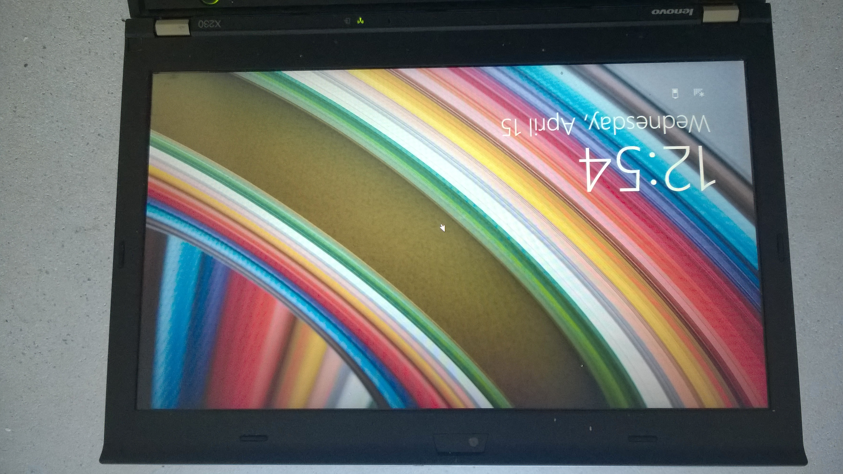
Take a computer and shut down
Standard Lenovo X230
with Win 8.1

Slide 34
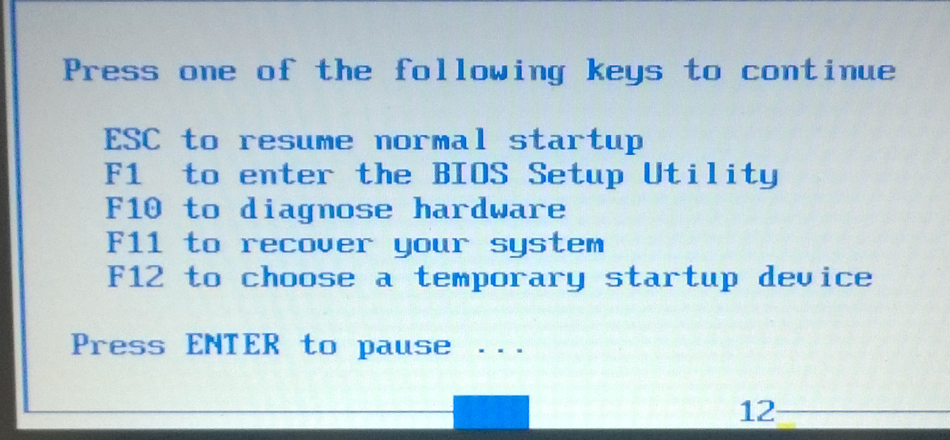
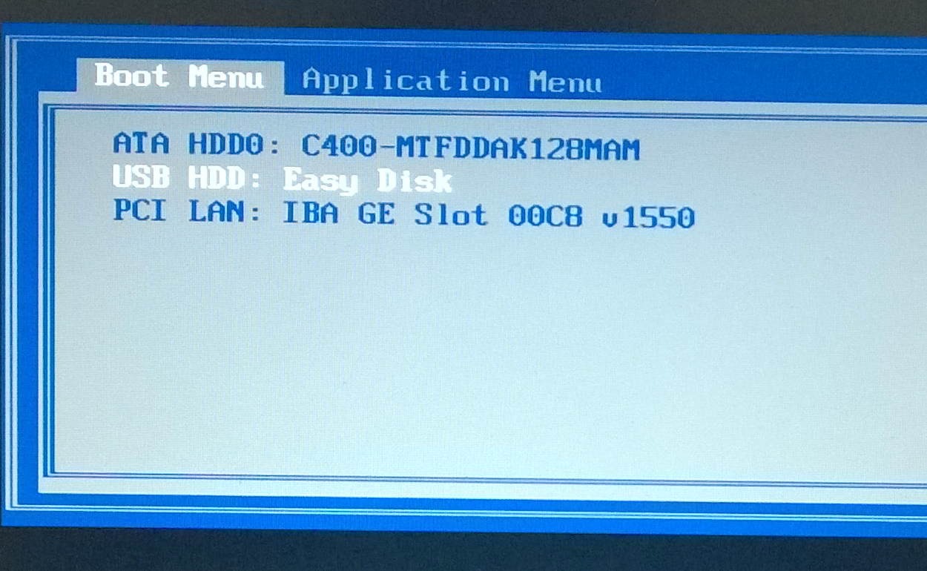
Insert Tails USB and boot from it
Choose boot device

Slide 35
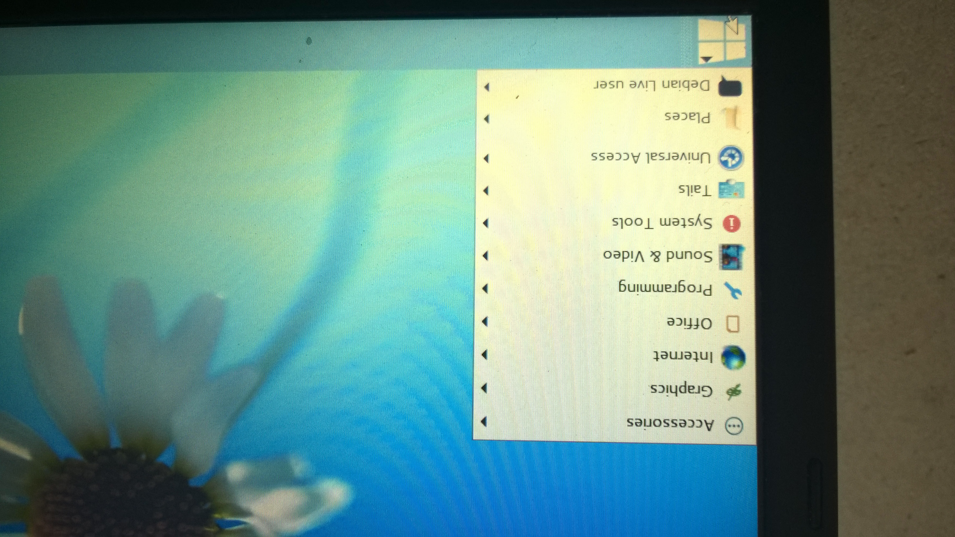
Tails on Lenovo
Shows general list of Tails software

Slide 36
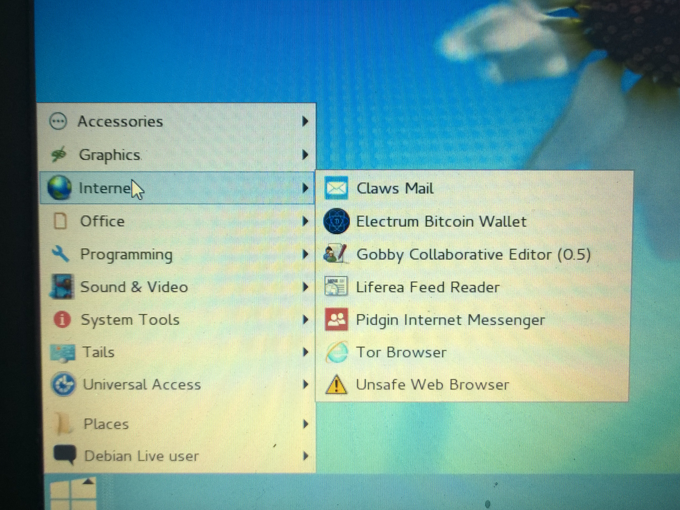
Tails secure internet software

Slide 37
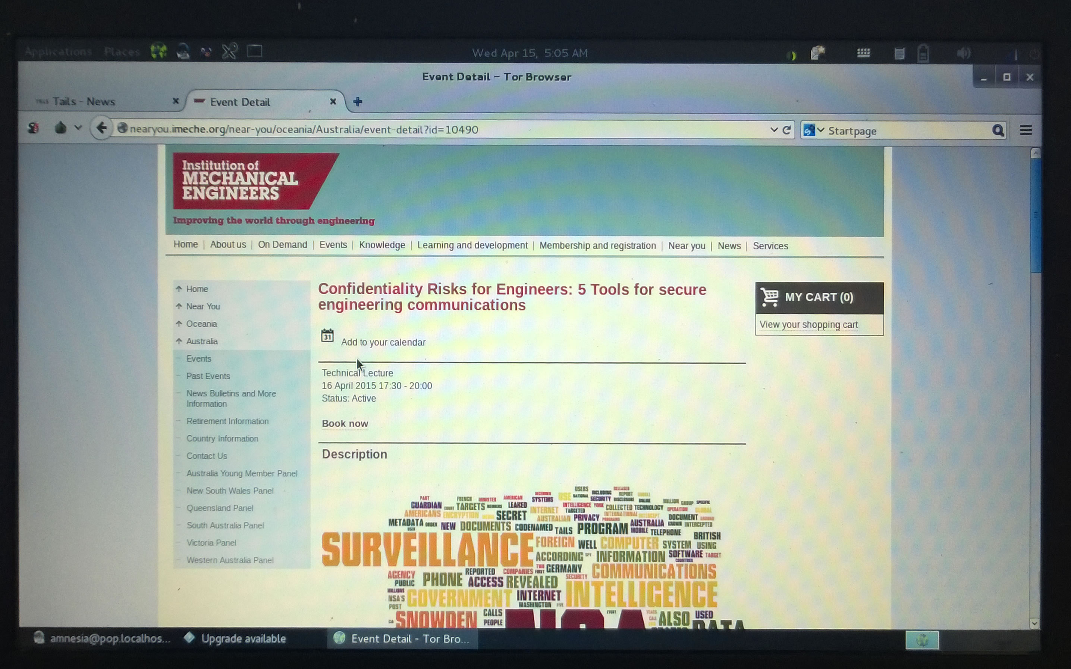
Tails using Tor Browser
Viewing IMechE Near
You website events via
the Tor Browser
Web searches are via
search engines that do
not record your details:
StartPage
DuckDuckGo

Slide 38
Installing Tails on a new USB
Use new blank 4Gb USB
Easiest is to clone usb using a computer already running Tails
Otherwise:
Download ISO file and create a Tails DVD
Use DVD to run Tails
Using computer running Tails, use Tails Installer to create new Tails USB
(https://tails.boum.org/doc/first_steps/installation/manual/index.en.html)

Slide 39
In conclusion
Step 1: Create a Threat Model for your situation
Step 2: Create a security plan that addresses the threats appropriately
Step 3: Install necessary software and use your security plan
In volatile situations, you may find it useful to carry Tails.

Slide 40
Questions?
Dr. Terence Love
admin@loveservices.com.au

Slide 41
Online courses on security
Interested in short online courses on security, confidentiality and privacy?
Sign up for the free Courses news at www.praxiseducation.com

